Slide 1
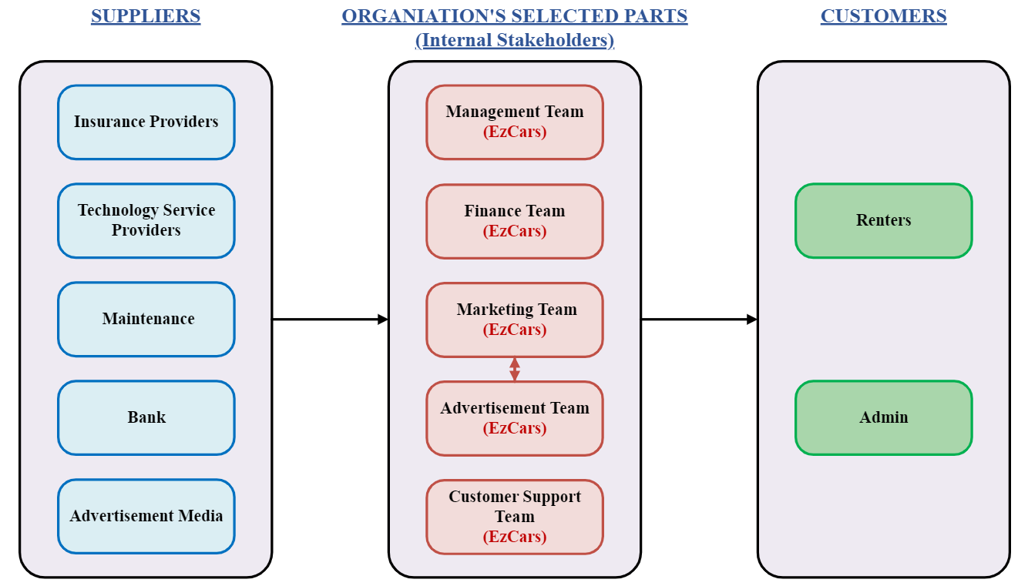
EzCars: Business Relationship Map

Slide 2
EzCars: SIPOC Diagram
S
I
P
O
C
Supplier
Inputs
Process
Outputs
Customers
Insurance Providers
Technology Service Providers
Maintenance
Advertisement Media
Bank
Vehicle inventory data
User data
Booking details
Payment information
Customer reviews
Vehicle availability status
Browse available vehicles
Rental Confirmations
Return Reminders
Payment Receipts
Security Deposit Holds and Releases
Credit Card Payments
Promotional Offers
Rating
Renters
Admin
Make Reservations
Secure Payments
Manage Bookings
Feedback
Promotions

Slide 3
EzCars: User Roles by Business Group
External Users (Customers)
Subscribed Customers (Harsh Patel)
Admin (Tarjanee Desai)
Internal Users
Business Group | User Roles | Team Member Name (Bus. Group Proxy)
Management Team | Manager Product Manager | Jitendra Rawat Prithvi Karkera
Finance Team | Accountant | Charitha Gangaraju
Marketing Team | Marketing Manager, Data Analyst | Avinash Bhavancheekar Krupali Dangshiya
Advertisement Team | Social Media Manager | Bhavin Goswami
Customer Support Team | Technical Support Specialist, Call Center Support | Sameera Shaik Chandraharsha Kosuri

